Slide 1
DATA REPRESENTATION
DATA REPRESENTATION MAY BE DECIMAL,BINARY,OCTAL OR HEXADECIMAL

Slide 2
What is Signed-magnitude Representation?
The representation of decimal numbers in everyday business is commonly called the signed-magnitude representation. In this system, a number consists of a magnitude and a symbol which indicates whether the magnitude is positive or negative.
Thus the decimal numbers + 79, - 82, - 25.2 etc. are interpreted in the usual manner.

Slide 3
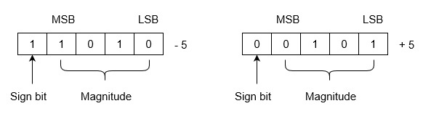
Let we are using 5 bits register. The representation of -5 and +5 will be as follows:
+5 is represented as it is represented in sign magnitude method. -5 is represented using the following steps:
(i) +5 = 0 0101
(ii) Take 1’s complement of 0 0101 and that is 1 1010.
MSB is 1 which indicates that number is negative.
MSB is always 1 in case of negative numbers.

Slide 4
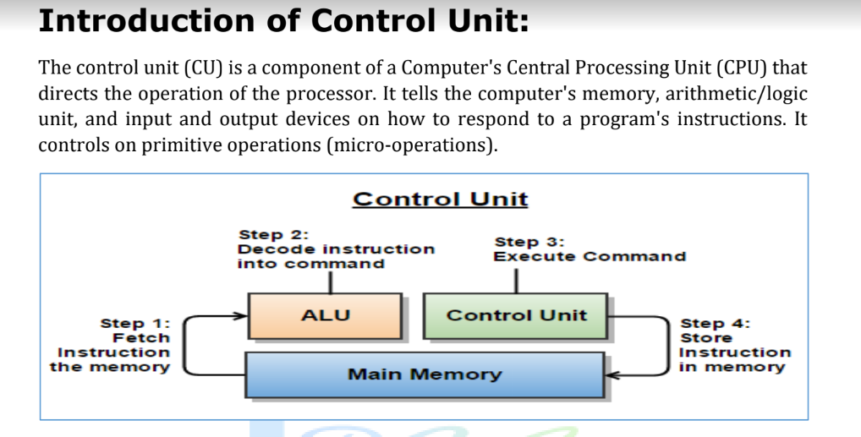

Slide 5
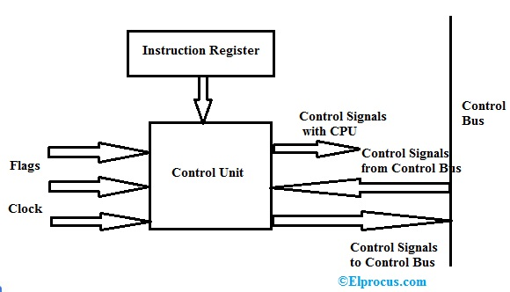
What is the Control Unit?
The component which receives the input signal/information/instruction from the user and converts into control signals for the execution in the CPU.
It controls and directs the main memory, arithmetic & logic unit (ALU), input and output devices, and also responsible for the instructions that are sent to the CPU of a computer.
It fetches the instructions from the main memory of a processor and sent to the processor instruction register, which contains register contents.

Slide 6
The control unit converts the input into control signals and then sent to the processor and directs the execution of a program. The operations that have to performed are directed by the processor on the computer. Mainly Central Processing Unit (CPU) and Graphical Processing Unit (GPU) require a control unit as the internal part.
Components of a Control Unit
The components of this unit are instruction registers, control signals within the CPU, control signals to/from the bus, control bus, input flags, and clock signals.
The components of the Hardwired control unit are instruction register (contains opcode and address field), timing unit, control state generator, control signal generation matrix, and instruction decoder.
The components of the Micro programmed control unit are the next address generator, a control address register, control memory, and control data register.

Slide 7
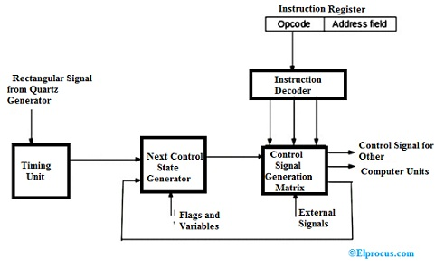
Hardwired Control Unit
In this type, the control signals are generated by a special hardware logic circuit without any change in the structure of the circuit. In this, the generated signal cannot be modified for execution in the processor.
The basic data of an opcode sent to the instruction decoder for decoding. The instruction decoder is the set of decoders to decode different types of data in the opcode. This results in output signals which contain values of active signals that are given as the input to the matrix generator to generate control signals for the execution of a program by the processor of the computer.

Slide 8
The matrix generator provides states of controls unit and the signals out from the processor (interrupt signals). Matrix is built as the programmable logic array.
For fetching of new instruction, the control unit turns into an initial stage for the execution of new instruction. The control unit remains in the initial stage or first stage as long as the timing signals, input signals, and states of instruction of a computer are unchanged.
The change in the state of the control unit can be raised if there any change in any of the generated signals.
When an external signal or interrupt occurs, the control unit goes to the next state and performs the processing of the interrupt signal. The flags and states are used to select the desired states to perform the execution cycle of instruction.
In the last state, the control unit fetches the next instruction and sends the output to the program counter, then to the memory address register, to the buffer register, and then to the instruction register to read the instruction.
Finally, if the last instruction (which is fetched by the control unit) is end instruction, then it goes to the operating state of the processor and waits until the user directs the next program.

Slide 9
Micro Programmed Control Unit
In this type, the control store is used to store the control signals which are encoded during the execution of a program.
The control signal is not generated immediately and decoded because the microprogram stores address field in the control store.
The micro-operations are done for the execution of micro-instructions in the program.
All the info of the control unit is permanently stored in the control memory called ROM.

Slide 10
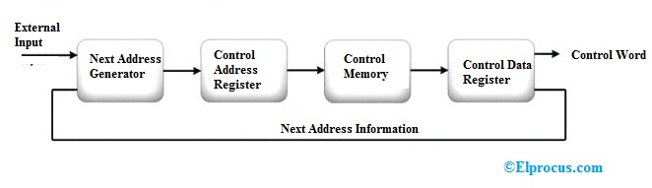
The micro-instruction from the control memory is held by the control register. Since the micro-instruction is in the form of control word (contains binary control values) that needs 1 or more micro-operations to be performed for the data processing.
During the execution of micro-instructions, the next address generator computed the next address of the micro-instruction and then send to the control address register to read the next micro-instruction.
The sequence of micro-operations of a micro-program is performed by the next address generator and acts as microprogram sequencer to get the sequence address i.e., read from the control memory.

Slide 11
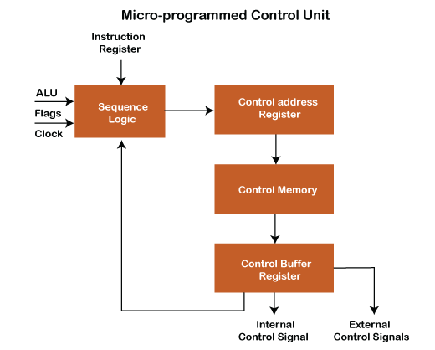
In this type, the control word is used to store the control signals encoded during the execution of a program and control words are stored in the memory.
Memory can be easily changed; we can change the value (0 or 1) in the control word, enabling and disabling signals.
we can easily update the control logic.

Slide 12
The sequence logic inputs are given by ALU flags, clock pulses and instruction register, which holds the instructions to be executed from the above diagram.
Instruction register-The instruction register sends data into sequence logic, and data is further sent to the control address register sequentially.
Control address register holds the address of the instruction/ control word data sequentially, sent by sequence logic. It holds the control word signals to execute the instruction and send them to control memory. It also helps to specify the address of the next micro-instruction to be executed.
Control memory is just a ROM (read-only memory). Control memory cannot perform any operation, and it's just read the data and stores the data input. Content of given control word in ROM at a given address specifies a micro-instruction required to execute the instruction. So, "A series of micro-instruction is stored in ROM." One instruction can be executed through the number of micro-operation/instruction cycle. Control memory used for another purpose also for example:-

Slide 13
Control memory is used to fetch, generate instruction from the main memory.
Used to evaluate effective address.
Execute the specified operation.
Store written operation used to fetch instruction.
Control buffer register- Data read from control memory is stored in the control buffer register, which sends internal and external control signals with which microinstructions are executed. Control buffer register sends a signal to sequence logic to execute the next instruction, and the same further process is carried out to execute the instruction.
Types of the micro-programmed control unit
The horizontal micro-programmed control unit
The vertical micro-programmed control unit
Advantage of MP control unit: Updating the control logic is easy as all the control signals are stored in memory, easily changed according to instruction requirements.
A micro-programmed control unit is implemented in high-level computers because it is easy to design, test, and implement.
The MP control unit's disadvantage is slower than the hardwired control unit because here, we have more flexibility in design.

Slide 14
Difference between Micro-programmed Control and Hardwired control unit
Hardwired Control | Micro-programmed Control
Hardwired control unit technology is circuit-based. | Micro-programmed control unit technology is software-based.
Flip-flops, gates, decoders etc., are used in the implementation. | In controlling the execution of instructions, signals are generated by microinstructions.
It uses the fixed instruction format. | It uses the variable instruction format (16-64 bits per instruction).
Instructions are register-based. | Instructions are not register-based.
For information and data (instruction), ROM (Read Only Memory) is not used. | For information and data (instruction), ROM (Read Only Memory) is used.
The hardwired control unit is used in RISC. | The micro-programmed control unit is used in CISC.
It does decoding at a very fast rate. | It provides slow decoding.
It isn't easy to modify, as it follows a fixed instruction format. | It is easy to modify as it follows a variable instruction format.
It has less chip area. | It has a large chip area.

Slide 15
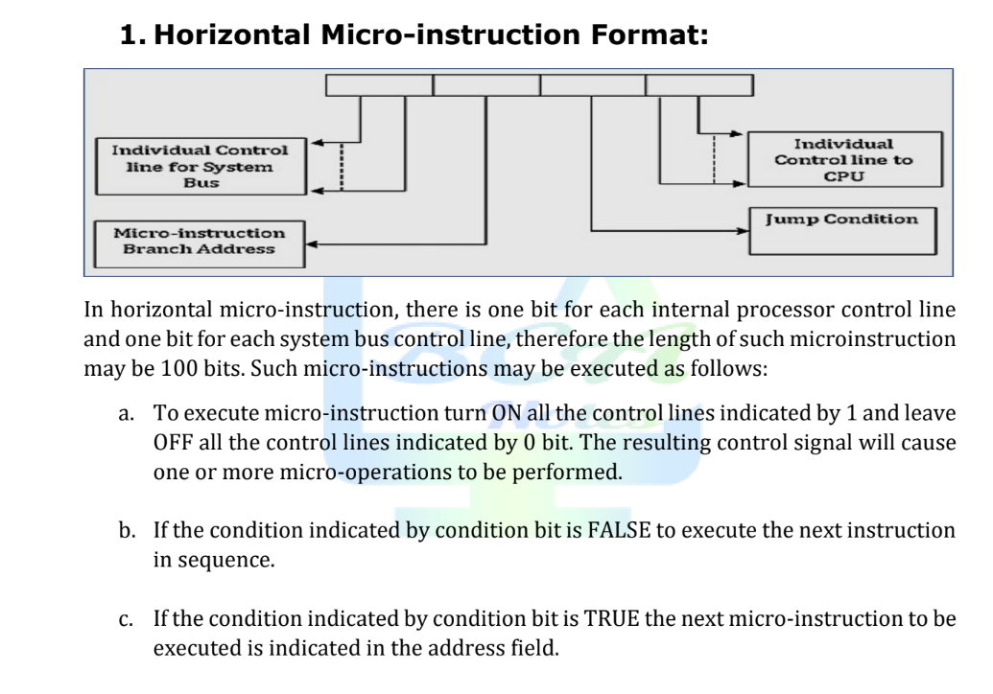

Slide 16
